Slide 1
MIS 7720 #4 Machine Learning

Slide 2
Intelligence and ML
Prediction and Learning as the essence of intelligence
Machine Learning needs data
Learning from data
Predicting based on data

Slide 3
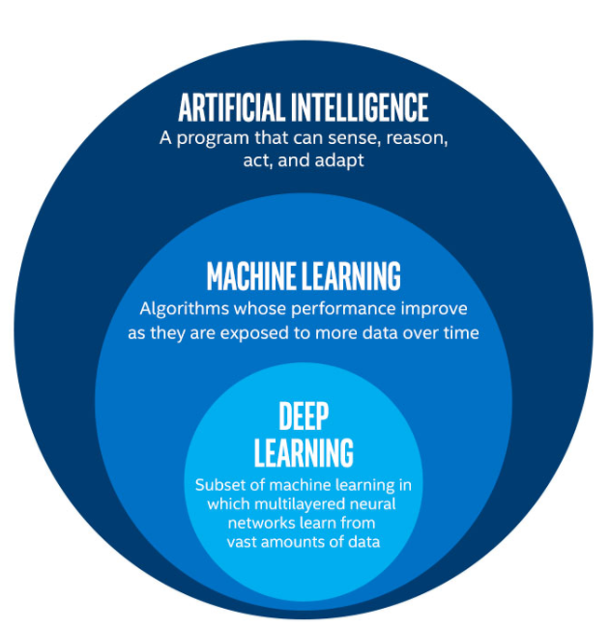
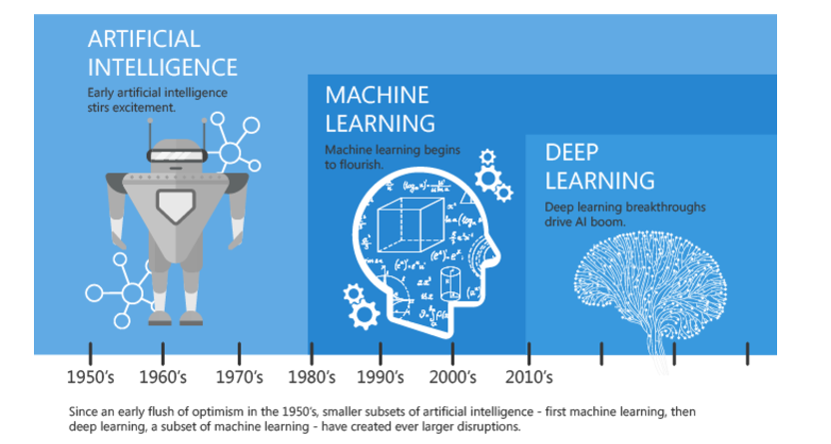
Machine Learning and AI

Slide 4
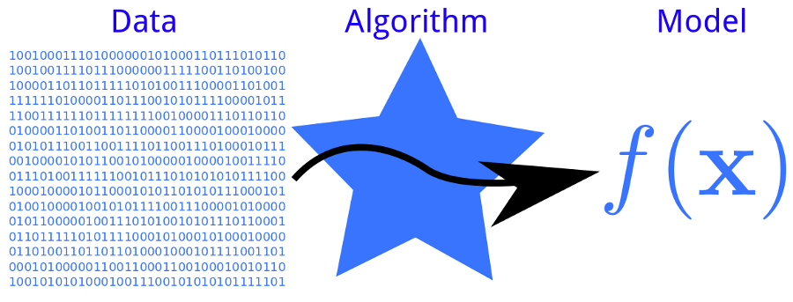
Machine Learning
Let’s use the model to make future decisions
More data is collected over time
Notes:
ML model: a (mathematical) representation of a real-world process
Learning here refers to the algorithm deriving/estimating parameters of the model from the data.

Slide 5
Overview
Supervised learning:
Building models from labeled data
Prediction, Classification
Unsupervised learning:
Building models from unlabeled data
Finding structure, patterns
Semi-supervised learning:
uses (small amount of) both labeled and (large amount of) unlabeled data at the same time to improve the performance of a supervised model
Reinforcement learning
Learn how to act to maximize cumulative reward.
No mathematical model assumption
Notes:
Supervised: The algorithm learns how to map input data to the outcome of interest
Unsupervised: the algorithm looks for patterns, trends, anomalies, etc. in the data
Reinforcement: algorithm learns what actions to take to maximize some given goal (using trial and error).
Self-supervised learning (& transfer learning): the system learns to predict part of its input from other parts of it input; i.e., a portion of the input is used as a supervisory signal to a predictor fed with the remaining portion of the input.
The BERT model used in natural language processing, for example, uses self-supervised learning.

Slide 6
Plan
Supervised
Unsupervised
Dimensionality reduction
Artificial Neural Networks (ANN) and deep learning
Revisit supervised and unsupervised learning
Reinforcement learning

Slide 7

ML algorithms in scikit-learn
Notes:
Source: https://scikit-learn.org/stable/tutorial/machine_learning_map/index.html

